Slide 1


SQLite
Database

Slide 2

Table of
Content
Introduction
Insert
Connection
Read
Cursor
Conclusion
Tables

Slide 3


Introduction
C Language Library that implements SQL engine

Slide 4



Introduction
Fast & Reliable
Stable & Cross Platform
Small & Lightweight
SQLite Database Features

Slide 5



Connection
Connect database with connect method of sqlite3 module
Python Code
Database

Slide 6
Cursor
Execute queries
Create cursor via cursor method of connection object
Cursor
Database

Slide 7
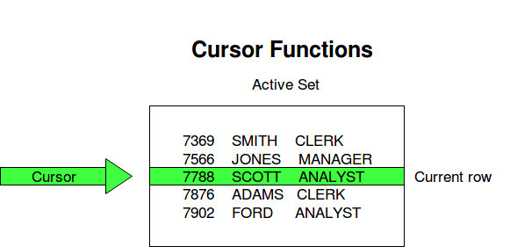
Cursor
Basically it is a pointer to the current row in the table

Slide 8

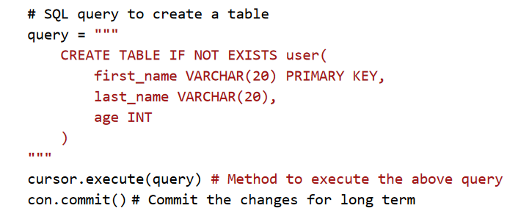
Tables
execute method of cursor executes the SQL queries
Create as many table as you want

Slide 9
Tables
commit method makes the changes for longer term

Slide 10
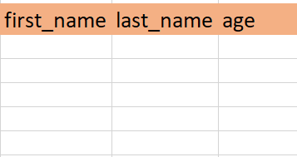
Created Table
Tables

Slide 11
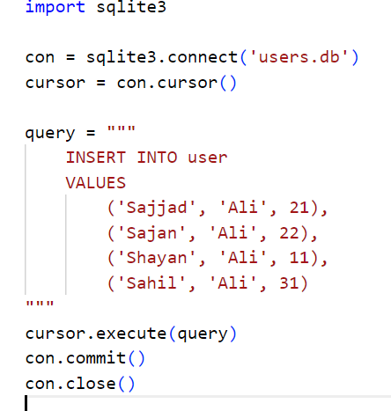
Insert
Same execute method is also used to insert data into table
closing the connection is important, or else there might be some problems or issues.

Slide 12
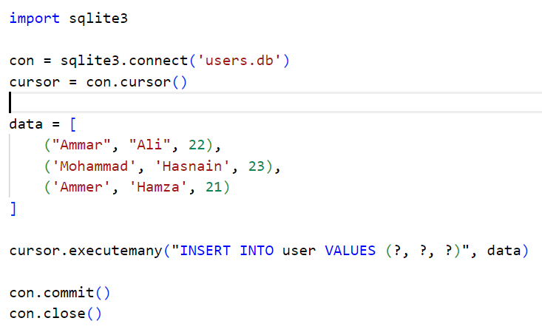
Insert
Use executemany with placeholders if you have data available as list or any iterable
Another appraoch to insert records in table

Slide 13
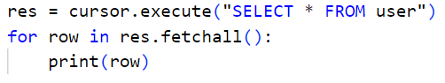
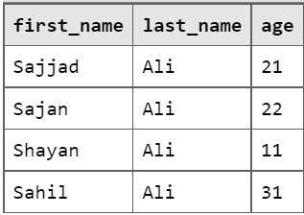
Read
Same execute method is also used to read from the table. It returns the resource object.
Its fetchall method returns the records as a 2d list.

Slide 14


Conclusion
You can also update and delete records using execute method similarly.
So, first
Connect to database
Create cursor
Execute queries
Commit the changes
Close the connection

Slide 15
Thank You

